Slide 1
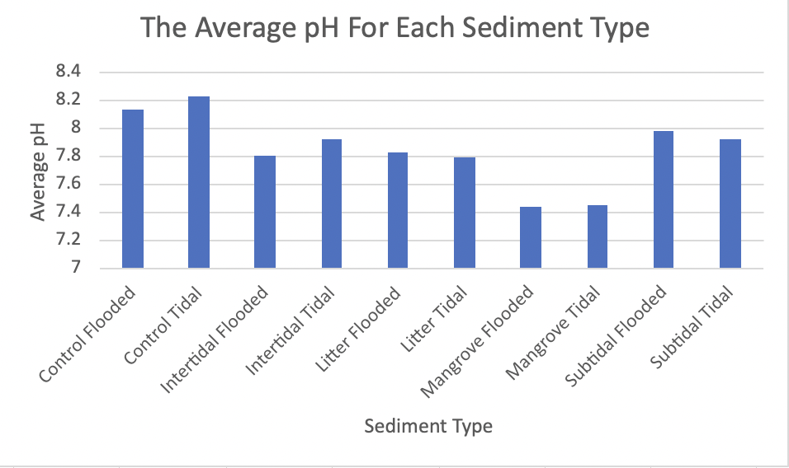
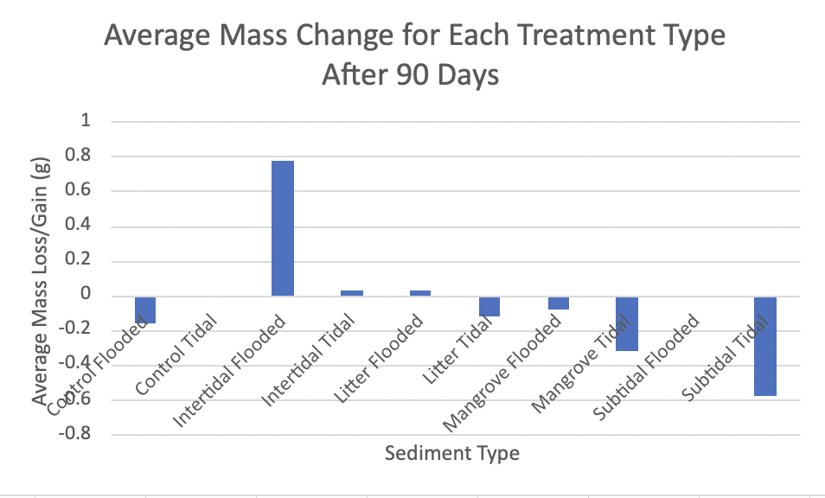
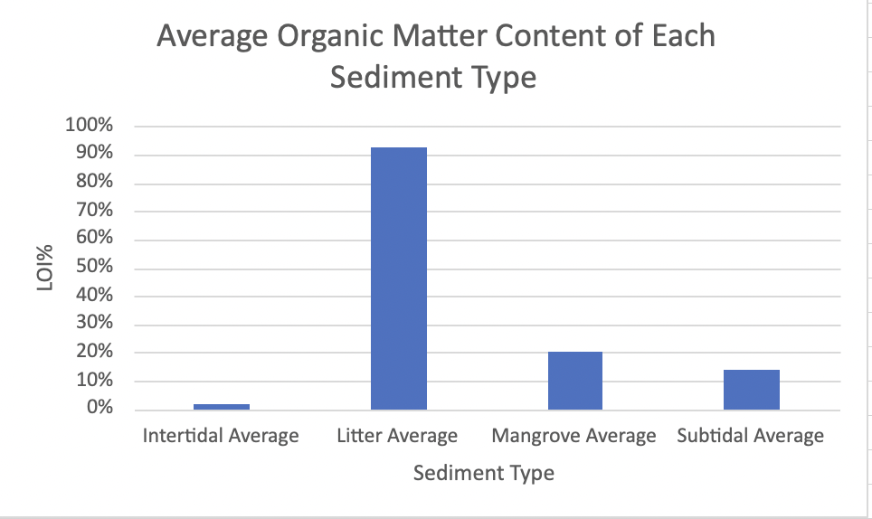
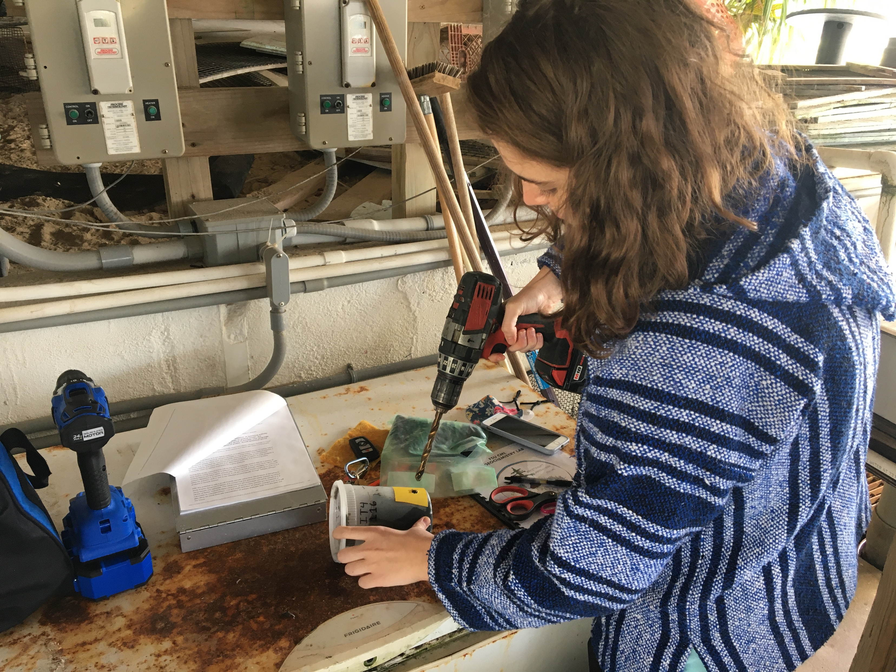
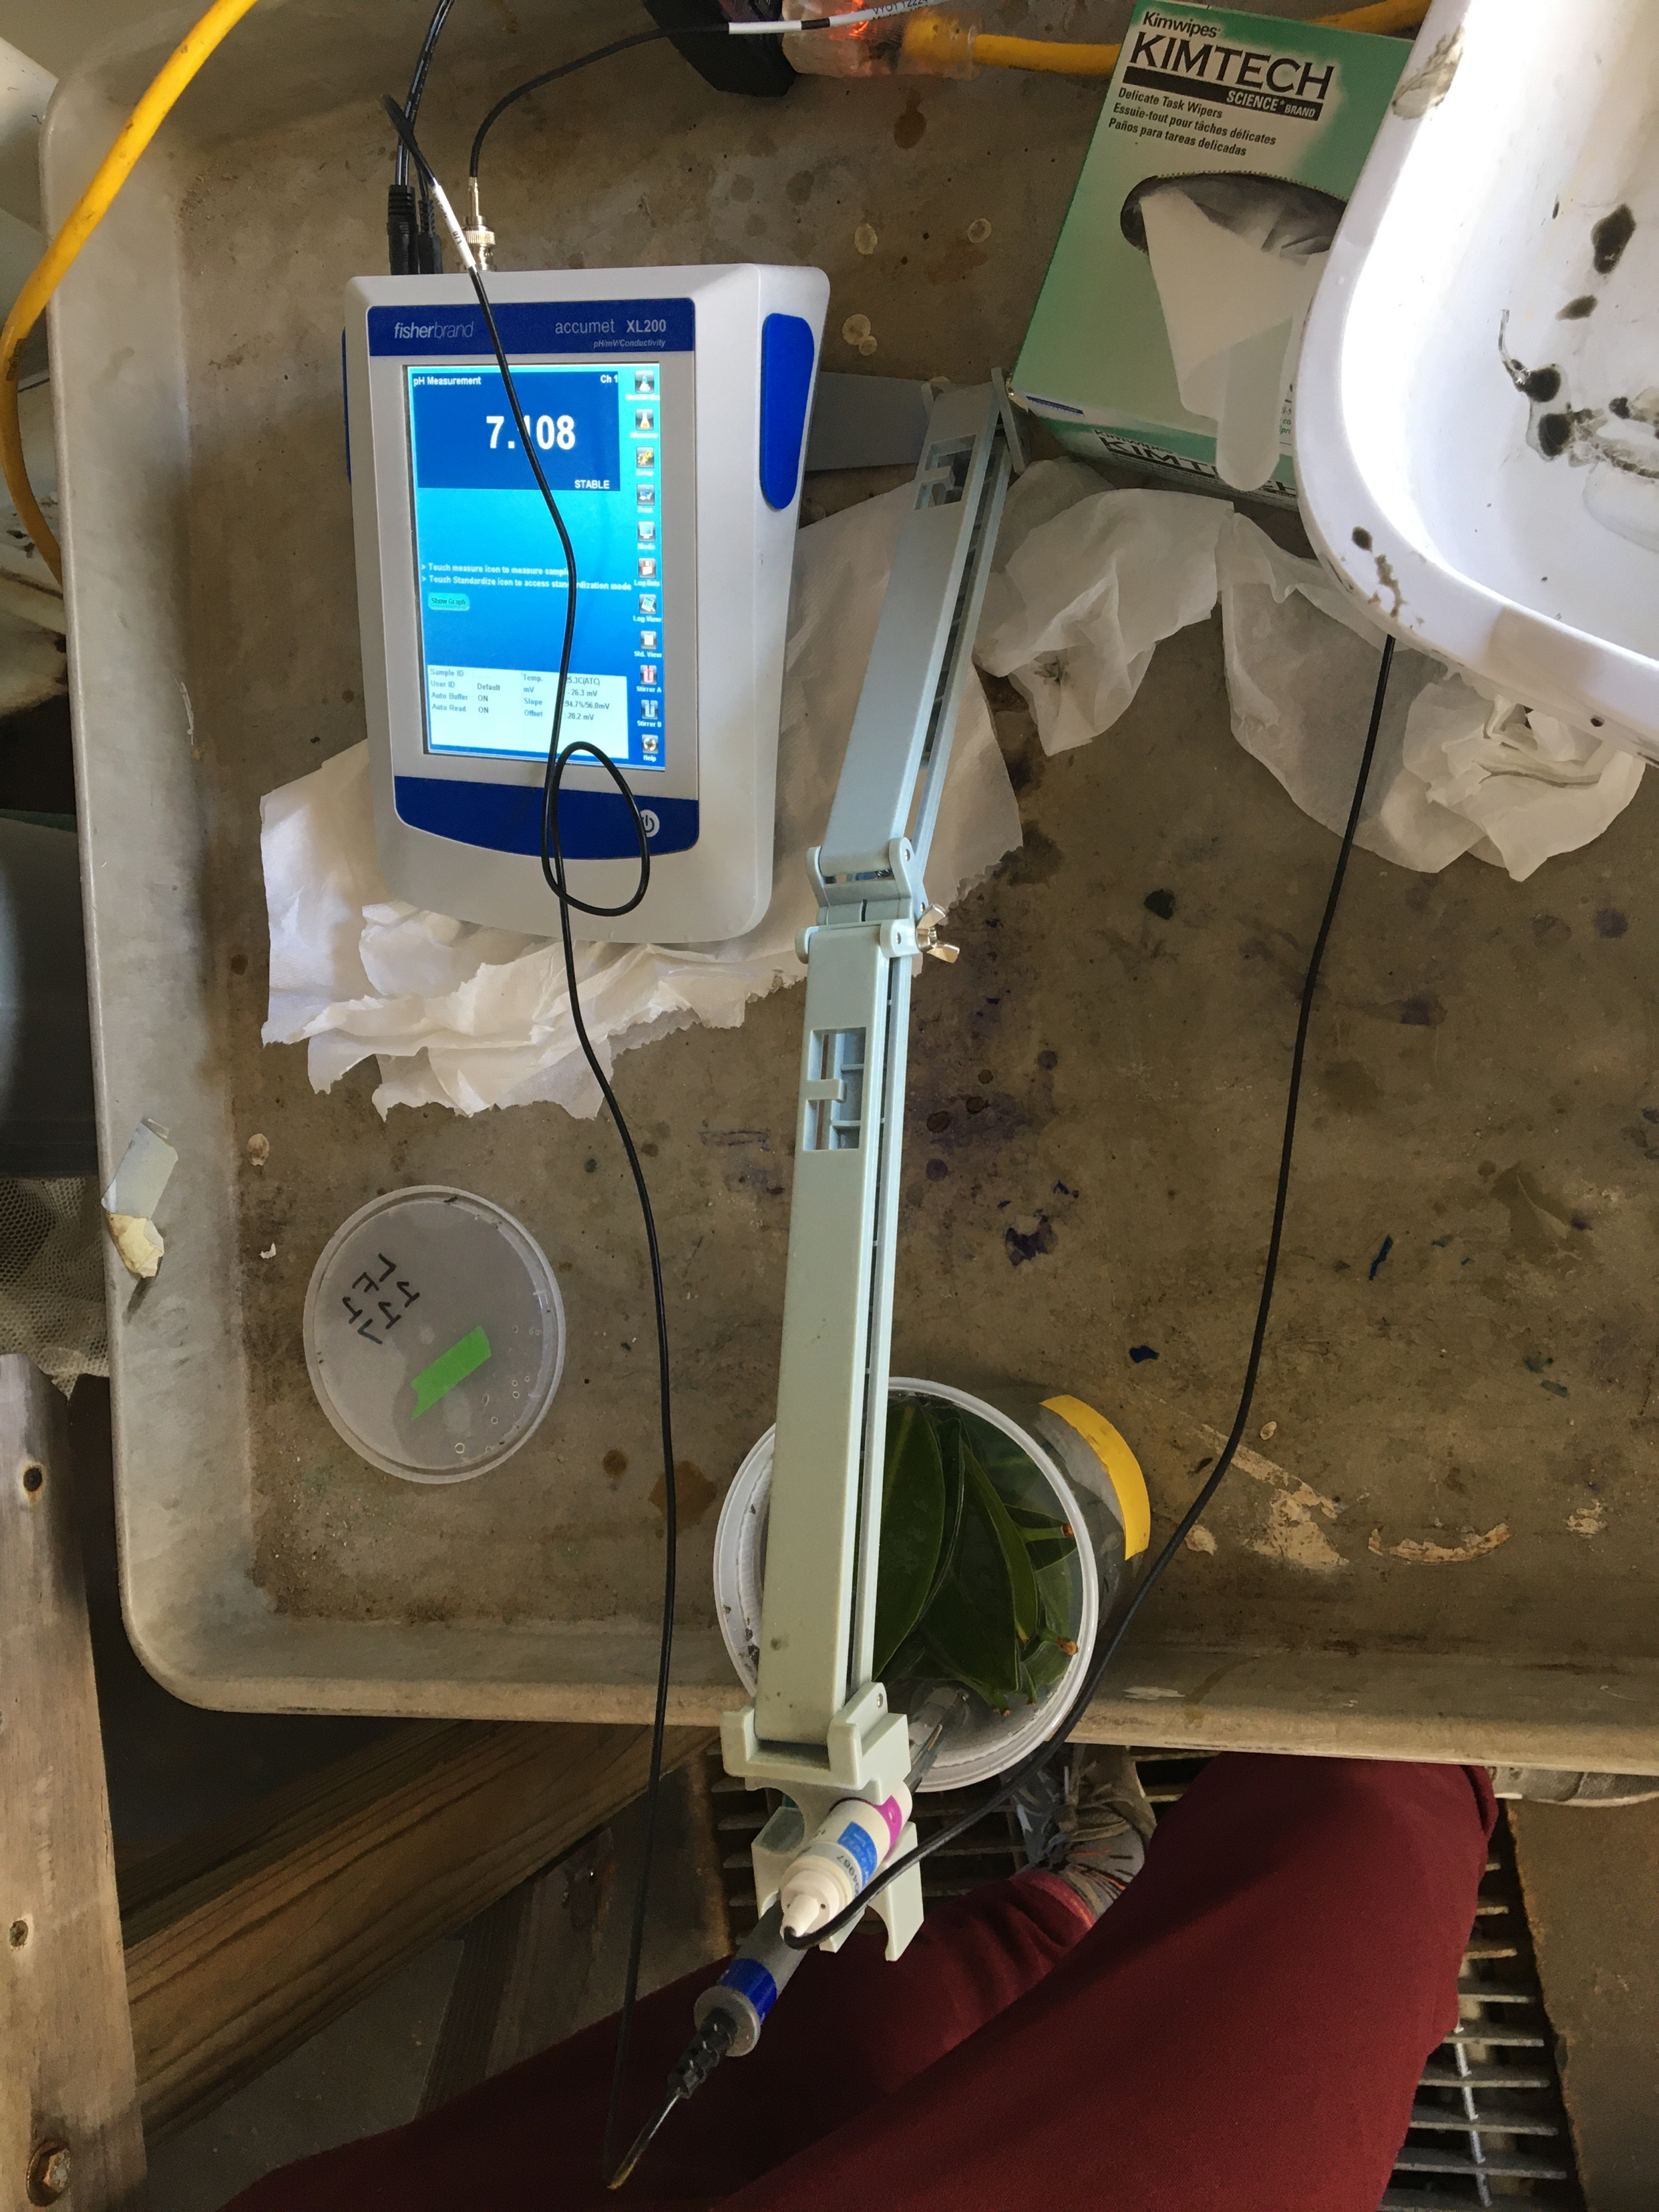
Quantifying the Effect of Sediment Organic Matter on Oyster Shell Dissolution
Anna Jacoby, Kevin Engelbert, Dr. Havalend Steinmuller
Research Mentor: Dr. Josh Breithaupt, Coastal & Marine Laboratory, Florida State University
Introduction
Methodology
Apalachicola Bay, once supplied 90 percent of Florida’s oyster population and 10 percent of the nation’s.
However, this oyster population has declined in the past decade and is currently closed to harvesting by the Florida Fish and Wildlife Conservation Commission. Causes for the decline are currently being investigated.
Scientists have tried to resurge an oyster population by creating viable oyster breeding grounds around the bay by dumping old, dormant oyster shells.
Female and male oyster egg and sperm join, creating a larva. The larvae then settle on hard substrate, which often includes oyster shell
When scientists went back to previous dumping sites, oyster shells had vanished. Researchers believed either oyster shells vanished due to sediment burial, redistribution or dissolution.
The objective of this study is to determine the effect of sediment organic matter content on shell mass loss, and ultimately to inform a better understanding of environmental influences on restoration efforts for the oyster population in Apalachicola Bay.
Oyster shells were placed in multiple types of sediment and checked for dissolution after 90 days.
40 cylindrical plastic containers had one-centimeter holes drilled in them and plugged with rubber corks
4 different sediment types were placed three quarters of the way in the containers and topped off with saltwater
the oyster shells were fully submerged in the water/mud
types of sediment included were intertidal, litter, mangrove, and subtidal
8 containers were filled with each mud type with one control group of solely saltwater
half of the containers were drained each week, by having the rubber corks removed, to simulate the tides of the ocean
the other half were never drained to simulate shells that are always covered with water
weekly, pH, temperature, and conductivity of each container was checked and marked down in a research notebook and Excel
Beginning at 90 days, we removed the oyster shells and recorded their clean, dry weights on the scale to see if any change in shell mass occurred. A loss of mass is interpreted as dissolution.
Results
It was found that in sediments with a moderate to high organic matter content and low pH, lost more shell mass. These sediments, such as mangrove, seem to produce the greatest amount of dissolution and cause the most potential disruption, causing larvae to not settle in these specific mud type areas.
Drilling holes into mesocosm containers to aid with weekly drainings
Conclusion
References
These findings suggest that oyster shell dissolution can occur in acidic muds such as Mangrove and Subtidal sediments. Because of this, oyster larvae may have a disposition to not settle on damaged, acidic shells in these regions, suggesting that planting oyster shells in such regions may not yield the most effective results.
Oakes, R. L., Peck, V. L., Manno, C., & Bralower, T. J. (2019). Degradation of internal organic matter is the main control on pteropod shell dissolution after death. Global Biogeochemical Cycles, 33(6), 749-760.
Reaves, C. M. (1986). Organic matter metabolizability andd calcium carbonate dissolution in nearshore marine muds. Journal of Sedimentary Research, 56(4), 486-494.
The 40 containers of each sediment type
Measuring pH of the mesocosms using a pH probe

